Slide 1


ANSIBLE 101
FOR THE WINDOWS SYSADMIN
Josh King
@toastit.dev @windos@mastodon.nz

Slide 2


Slide 3
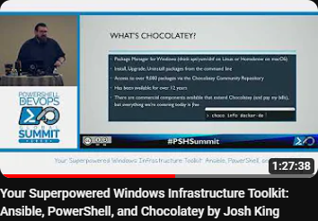






What is this Talk?

Slide 4







What is Ansible?
Infrastructure Provisioning
Configuration Management
Infrastructure as Code

Slide 5
Important Concepts
Ansible runs from a Linux host.
You could use WSL or a full VM.
Your configuration code is written in YAML.
Commands are executed on the target host.
Except when they aren’t.
Ansible is Linux first.

Slide 6
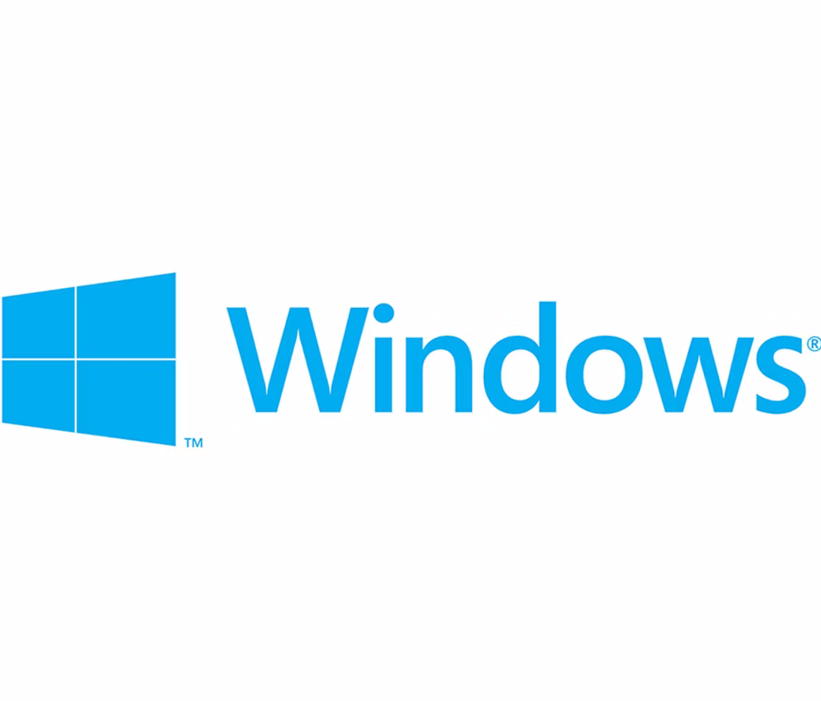

Ansible for Windows
Requires WinRM connection between Ansible and target.
SSH is possible.
Lots of auth options, including Kerberos and NTLM.
Windows “commands” are prefixed with “win_”.
i use
btw

Slide 7
Demo

Slide 8

Where to From Here?
Have a go!
Learn to love YAML and Linux.
Checkout the resources listed here:
toast.click/ansible

Slide 9
Questions?

Slide 10

THANK YOU
Please review this session
Get in touch:
Josh King
@toastit.dev
@windos@mastodon.nz

